Slide 2




density
x-momentum
y-momentum
energy

Slide 3
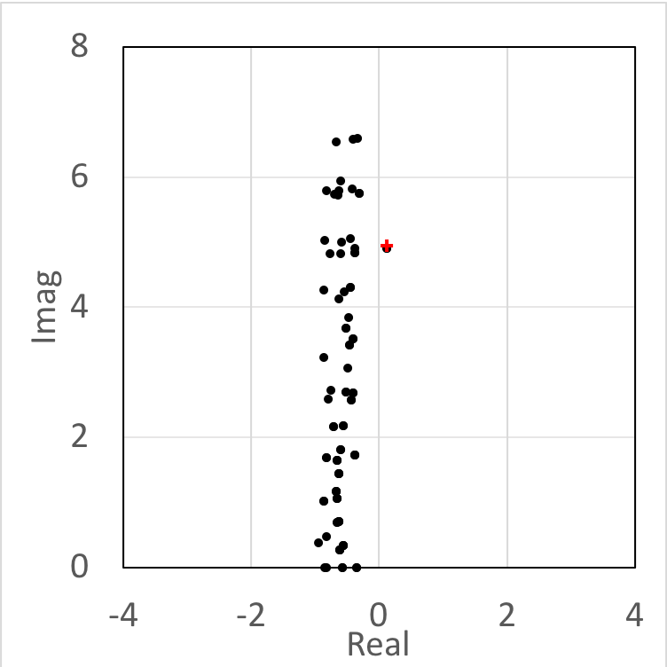
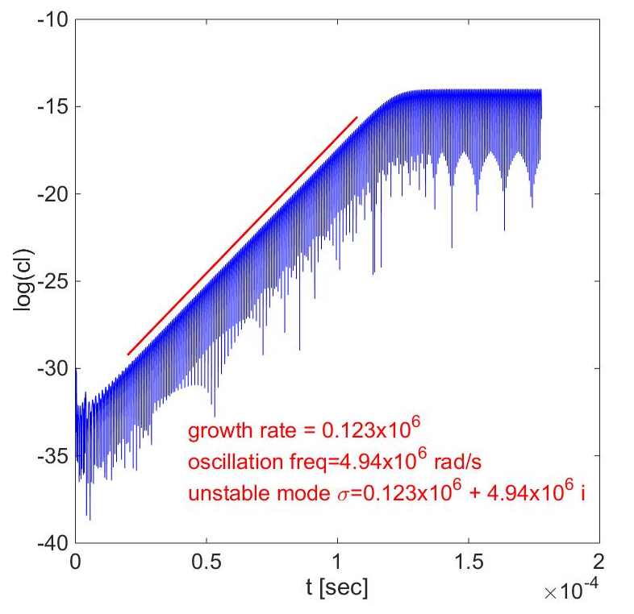
Eigenvalues computed
based on steady state
Extracted from
unsteady simulation

Slide 4
stable
unstable
unstable
x
stable
critical
condition

Slide 5
One eigenmode gradually destabilizes when it
crosses the imaginary axis (Hopf bifurcation)

Slide 8
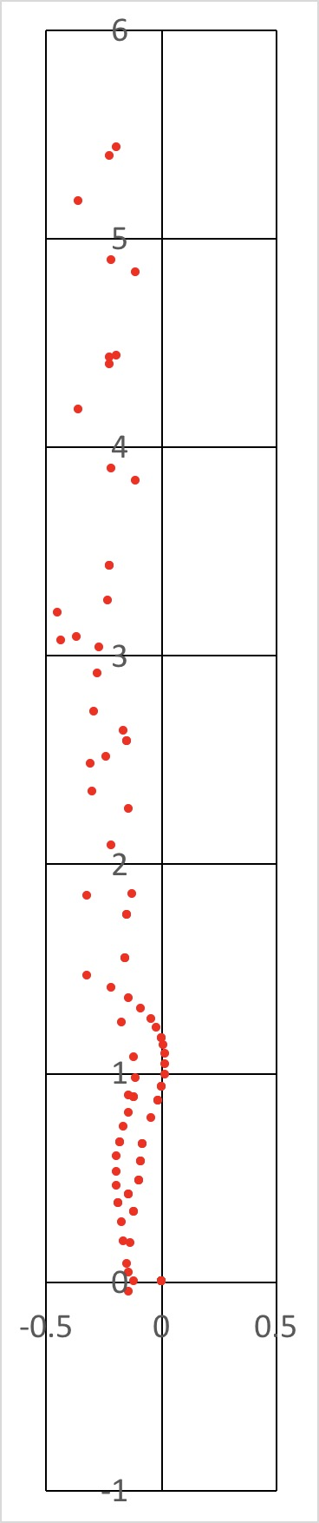
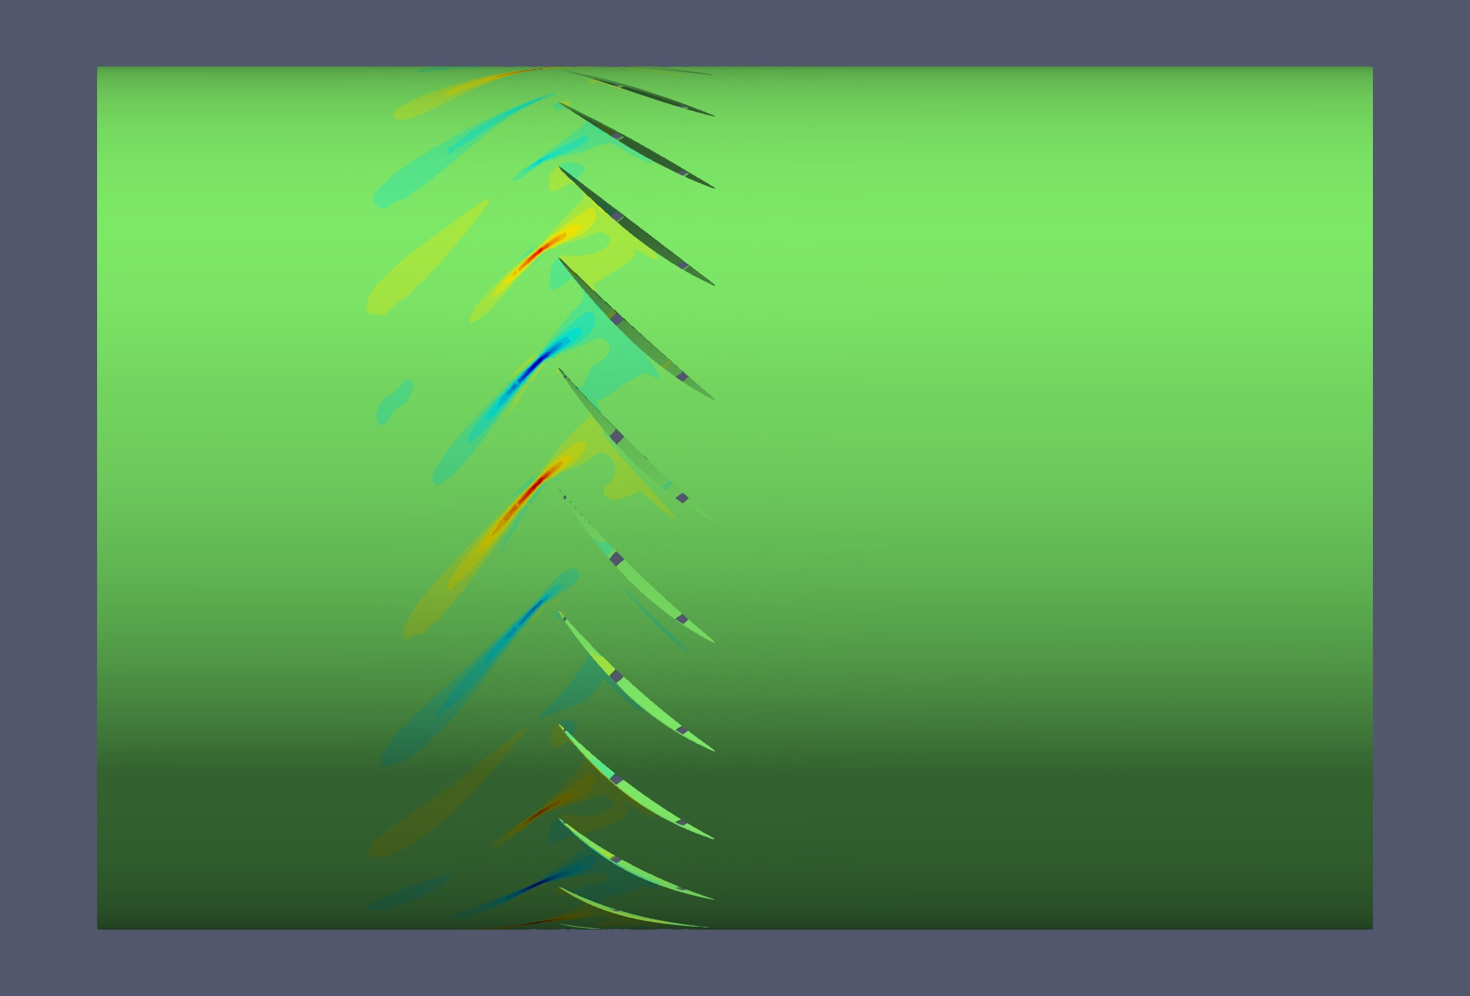
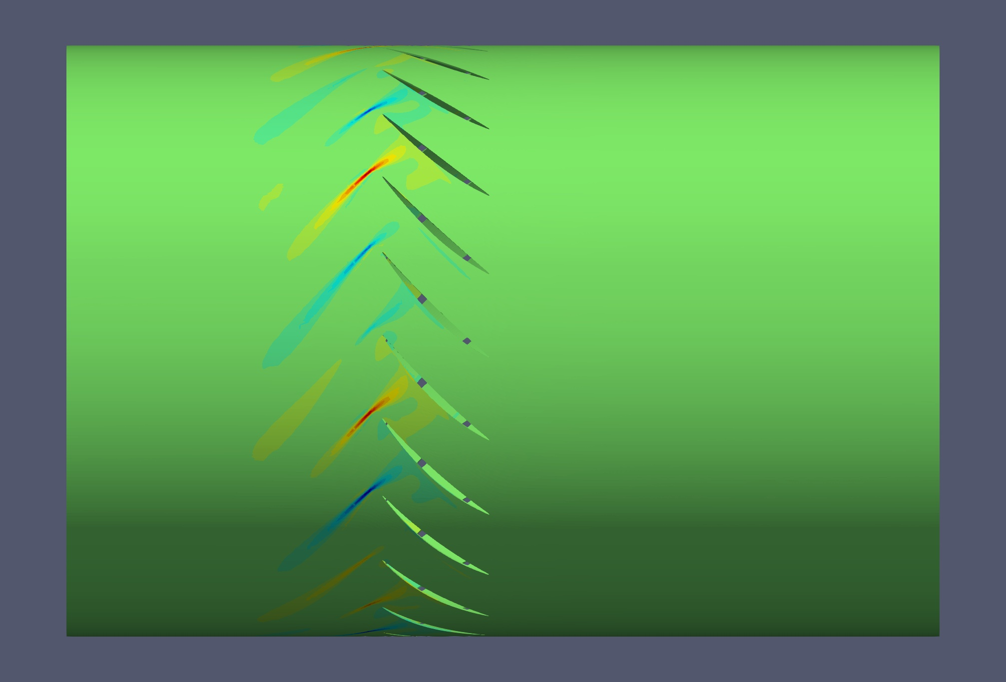
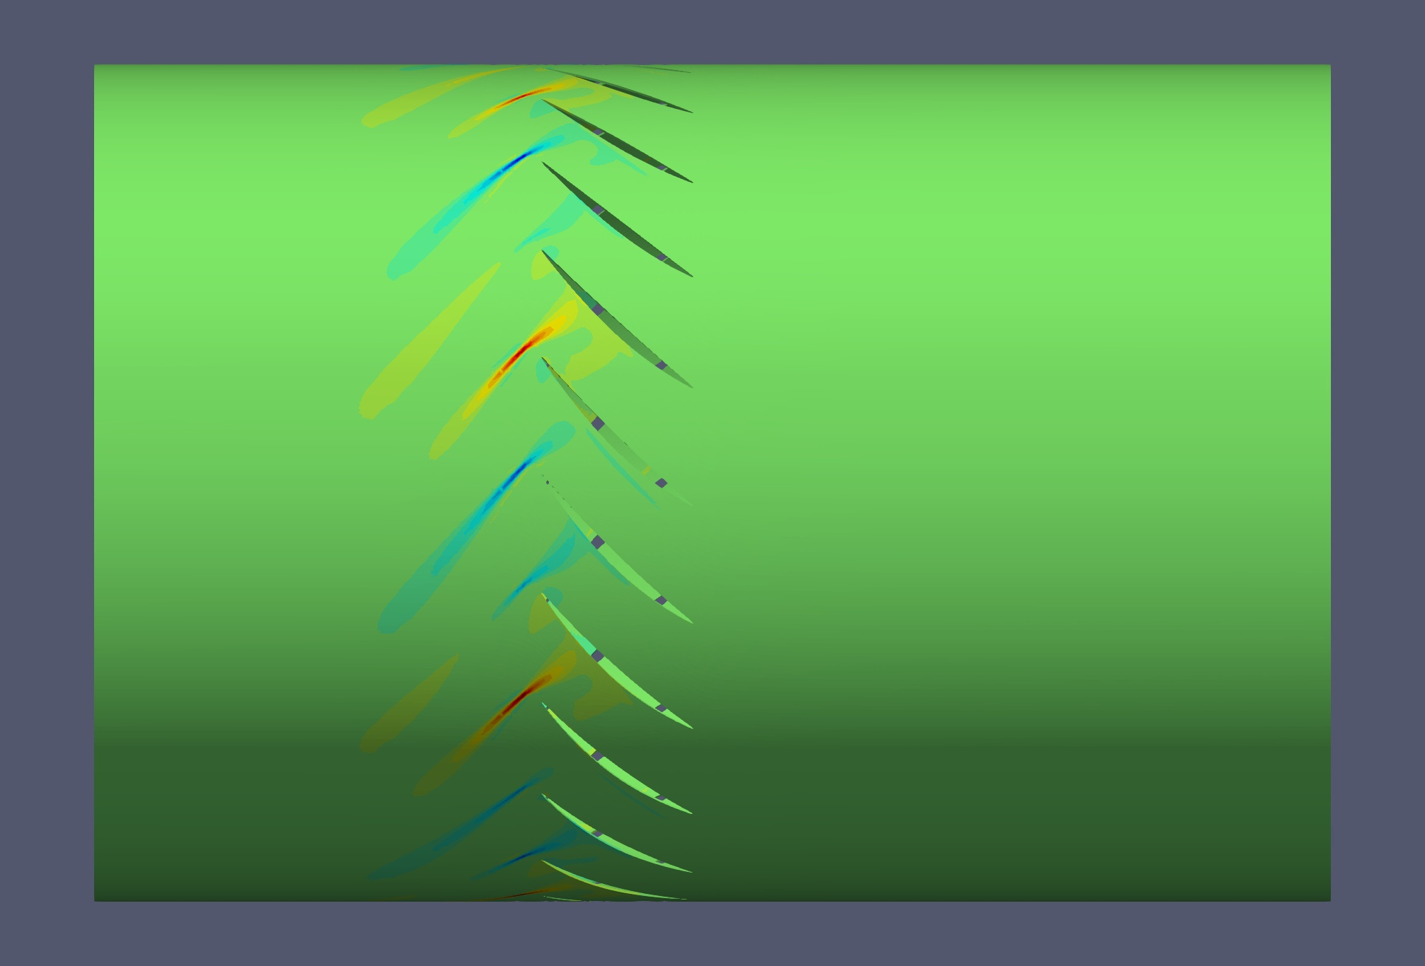
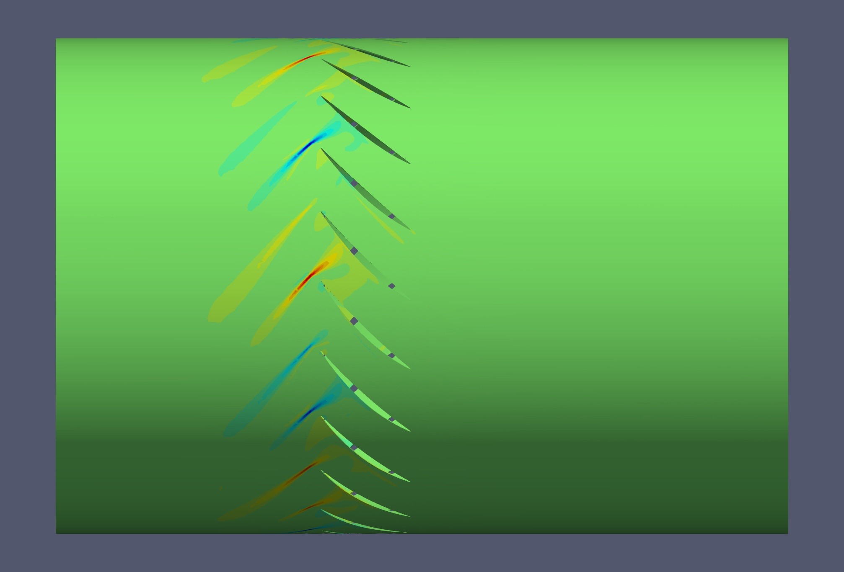
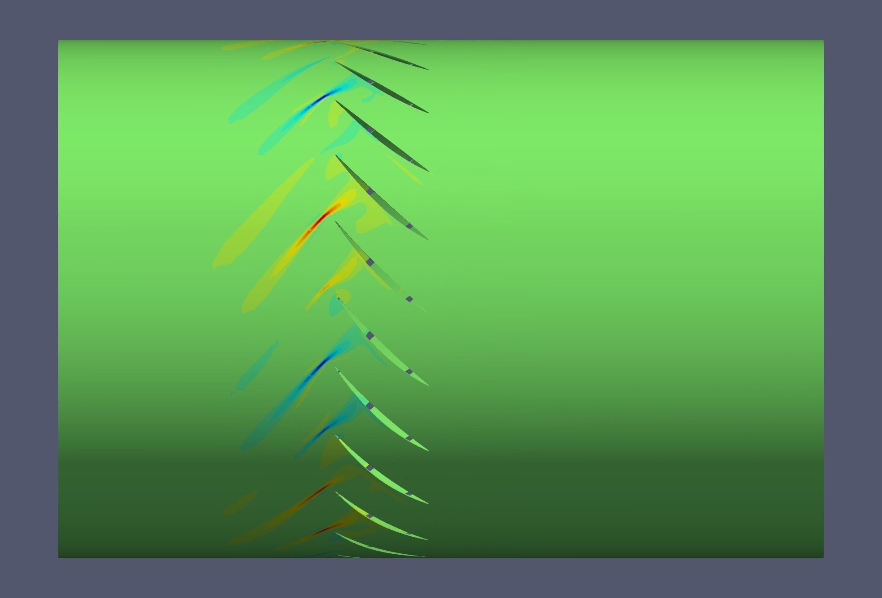

Slide 9
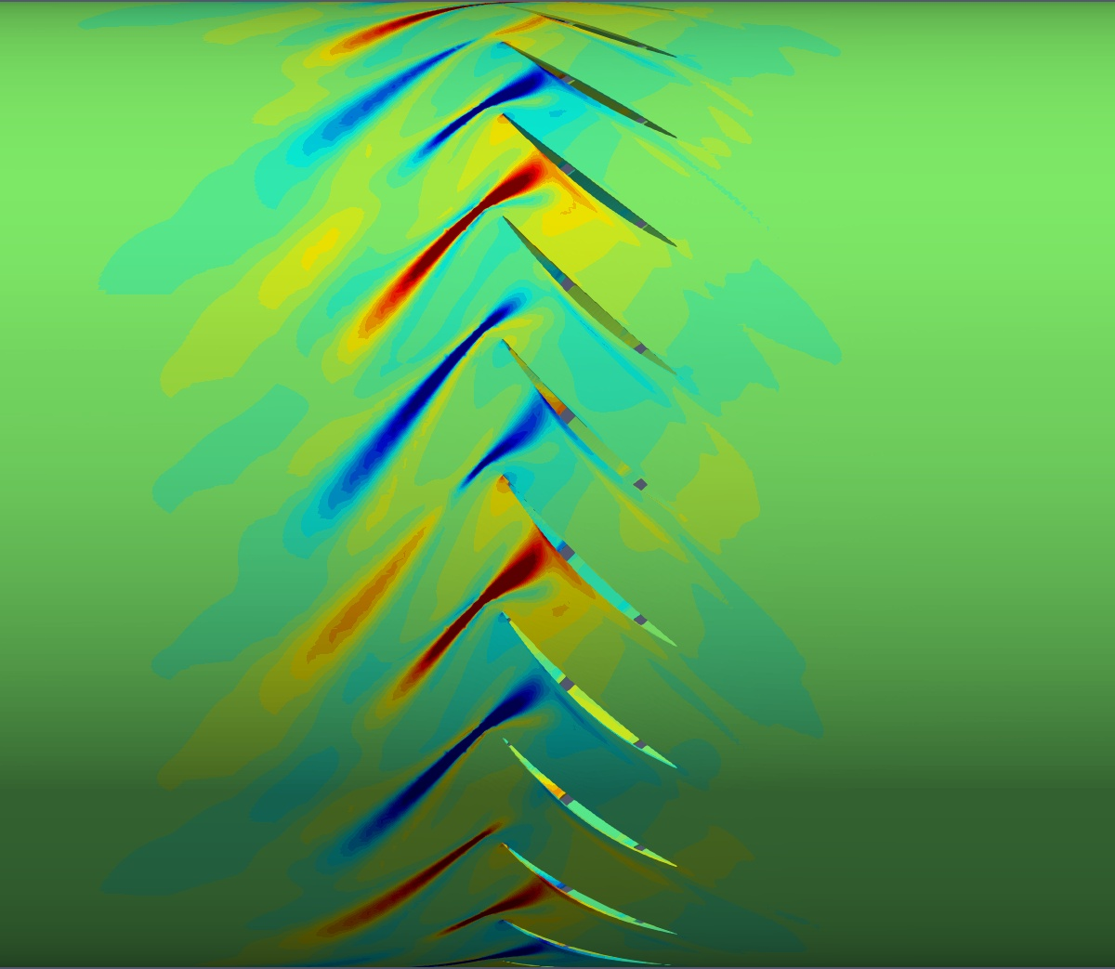
stable
unstable
eigenvector 3
(pressure)
5
4
3
2
1

Slide 11
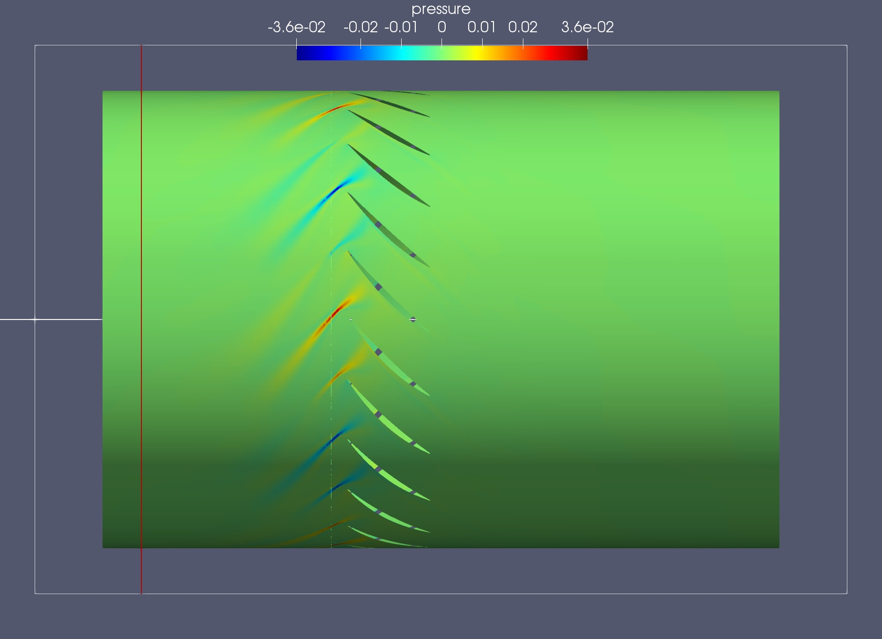
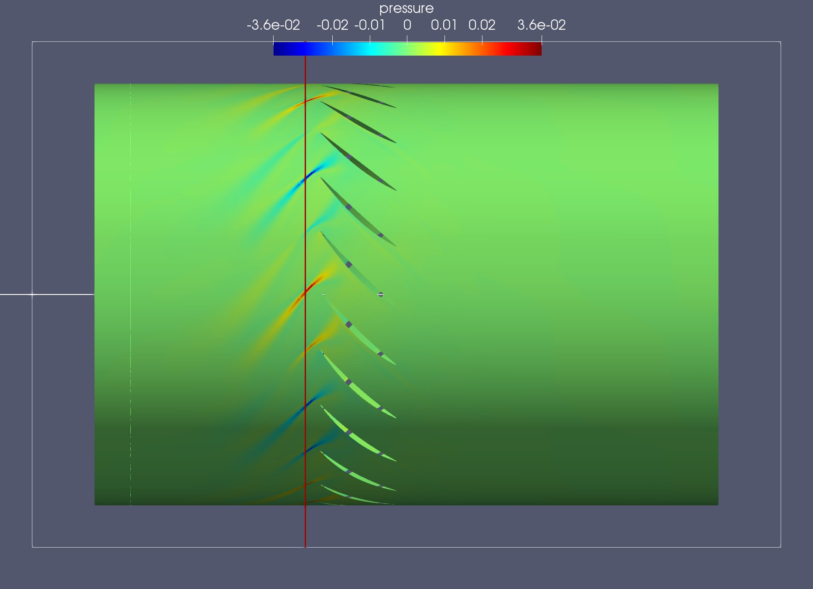
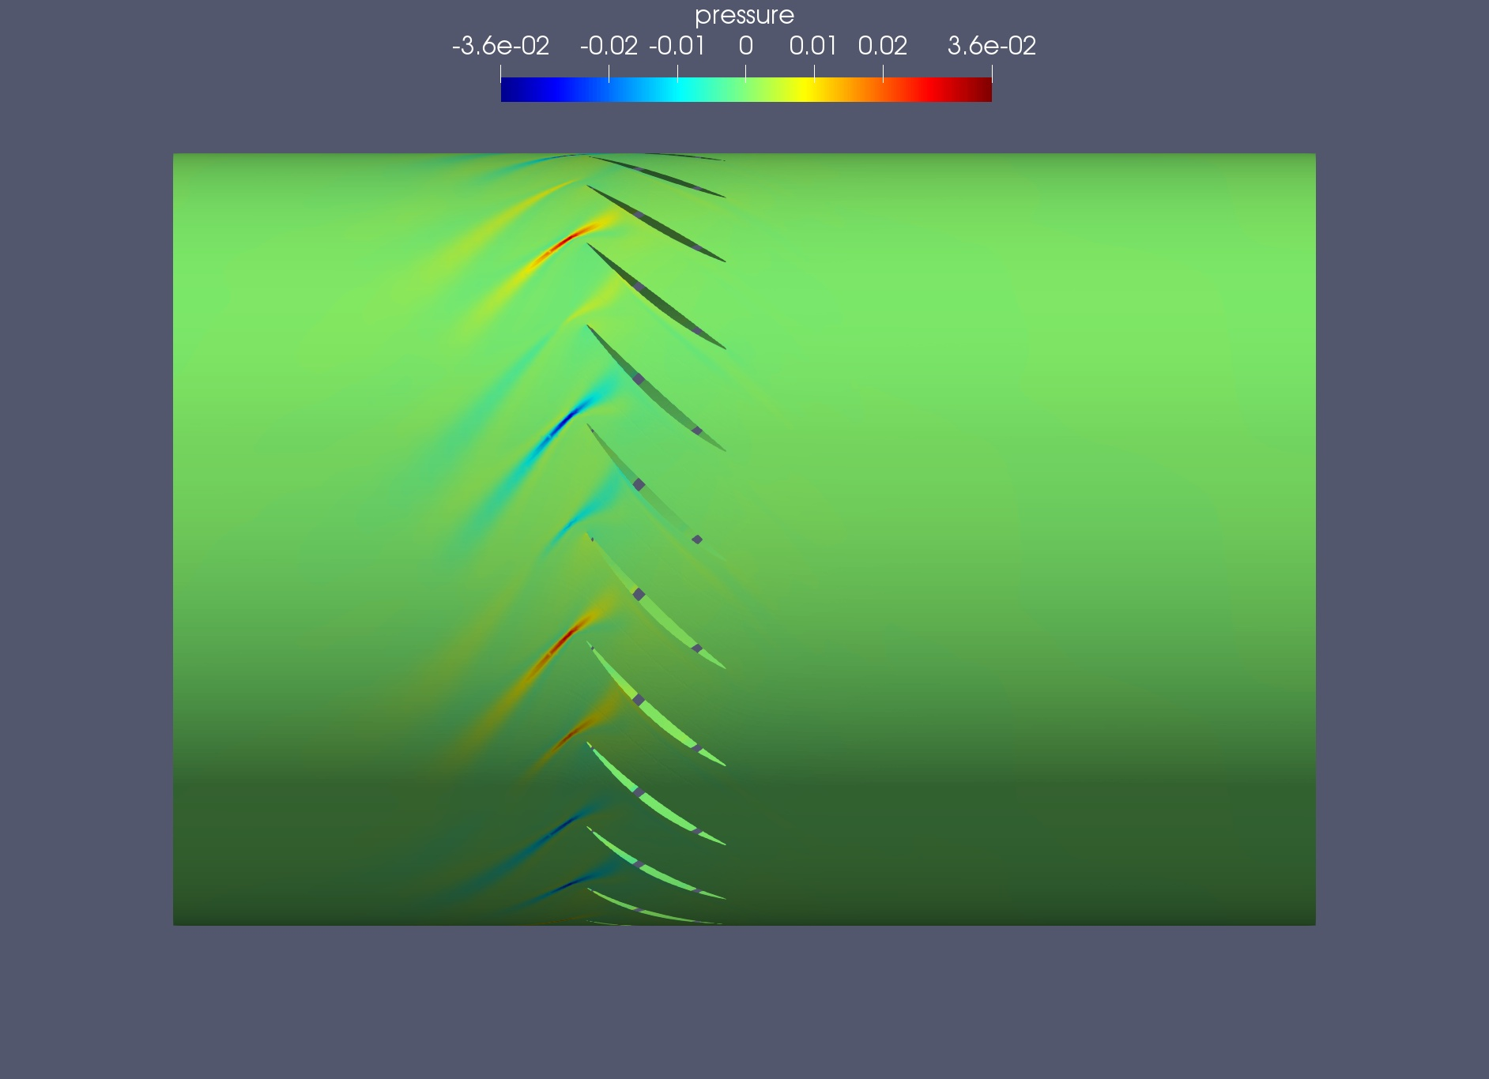
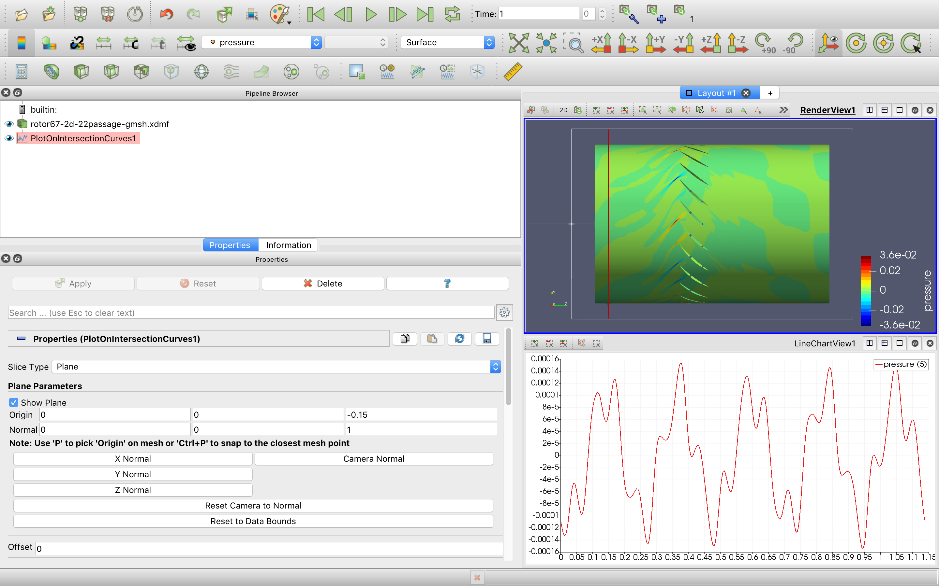

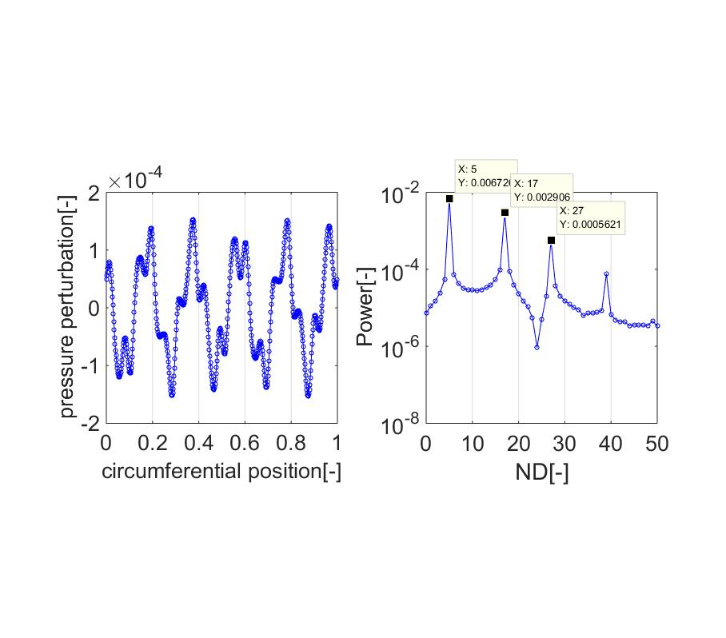
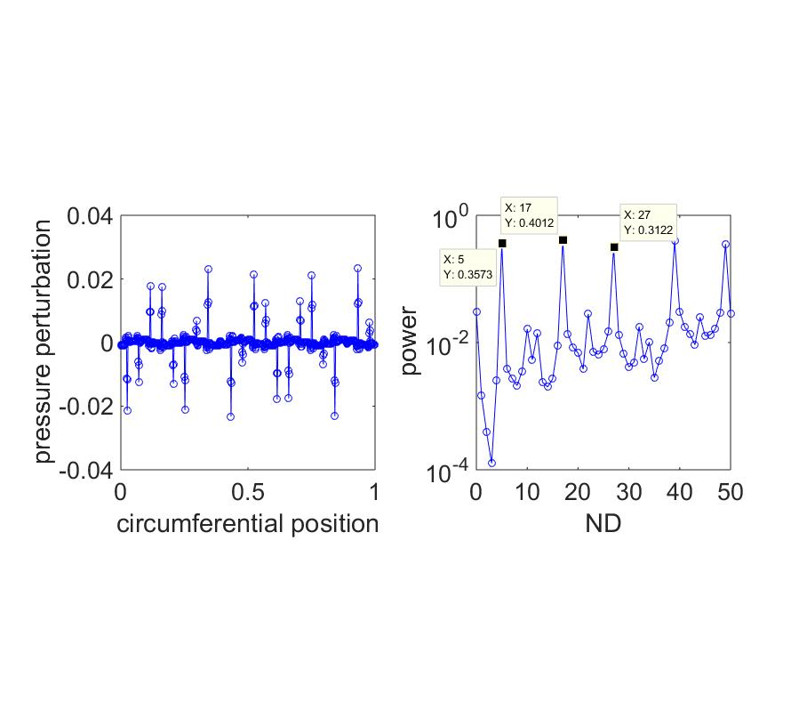
Real part
Imaginary part
Position 1
Position 2
Circumferential pressure perturbation
FFT
FFT

Slide 12
Real part
Imaginary part

Slide 13
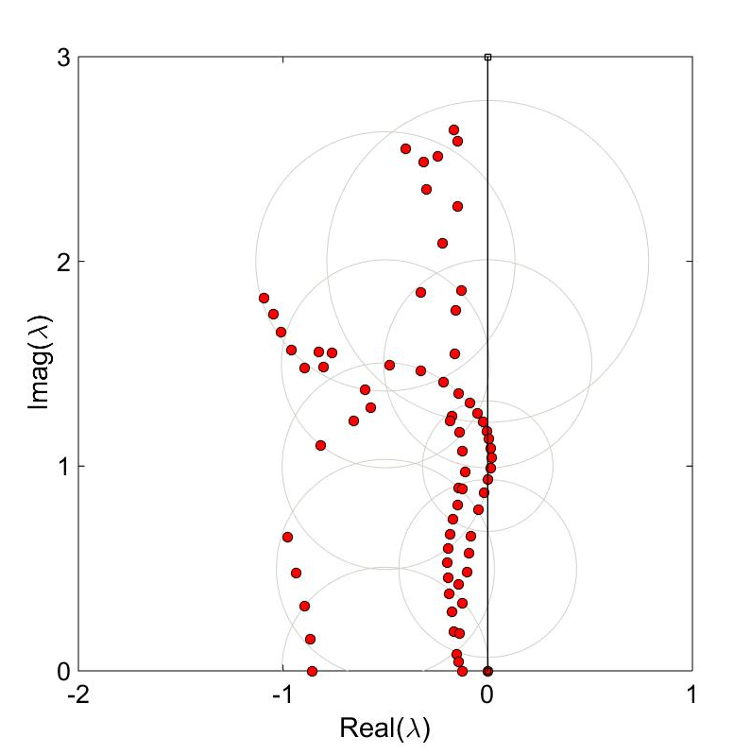

Slide 14
Eigenvalue approach for stability analysis
Shenren Xu
2019 April 19

Slide 15
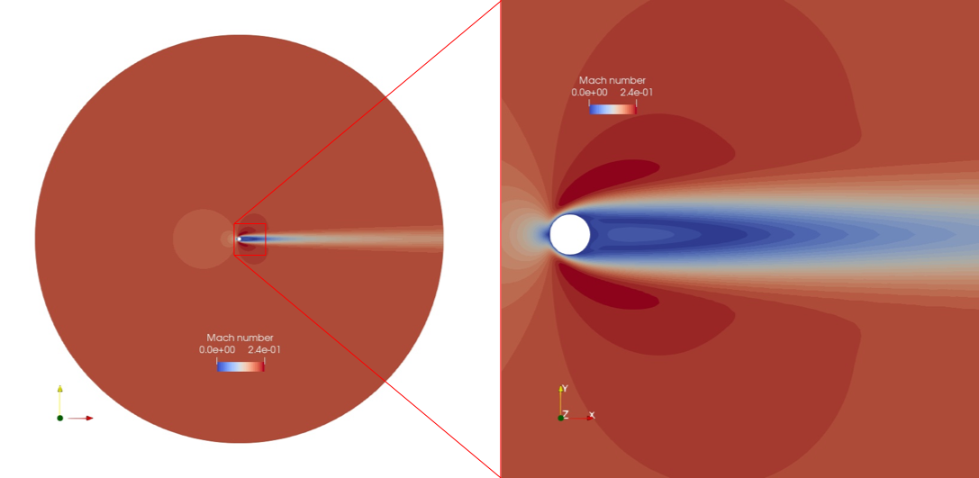
Test case 1: laminar flow around a cylinder

Slide 16
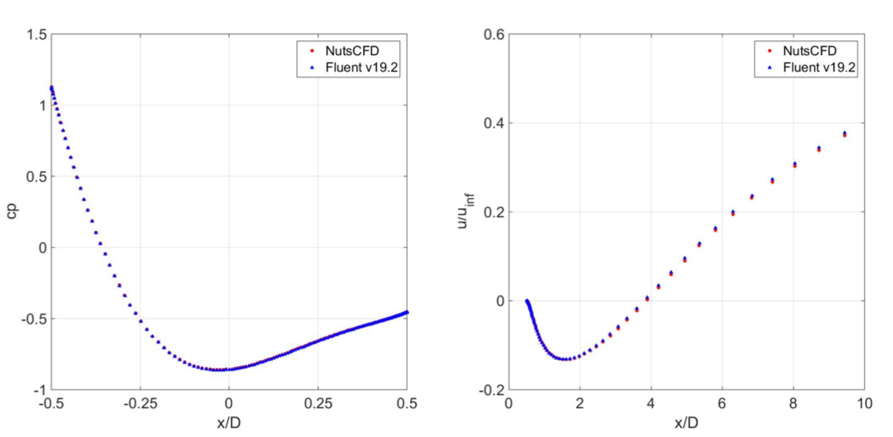
Comparison between NutsCFD and Fluent

Slide 17
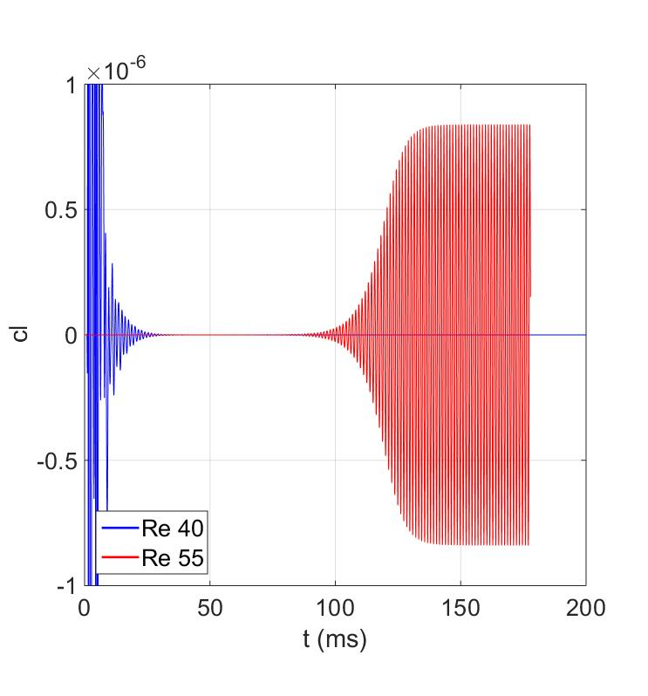
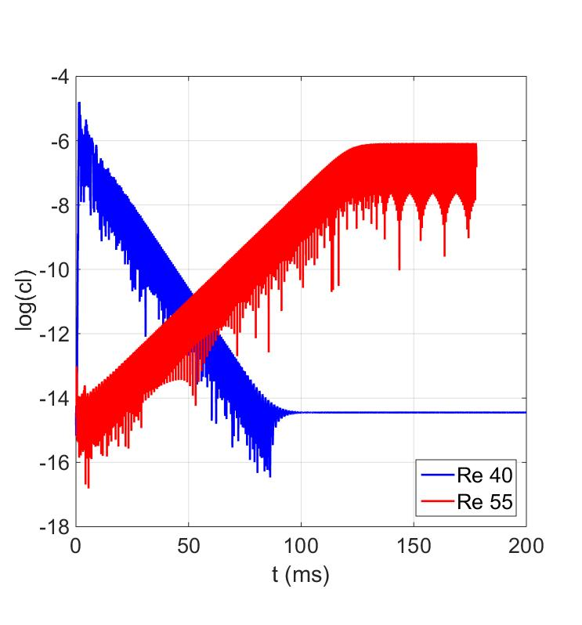
Unsteady analysis using Fluent for Re=40, 55

Slide 18
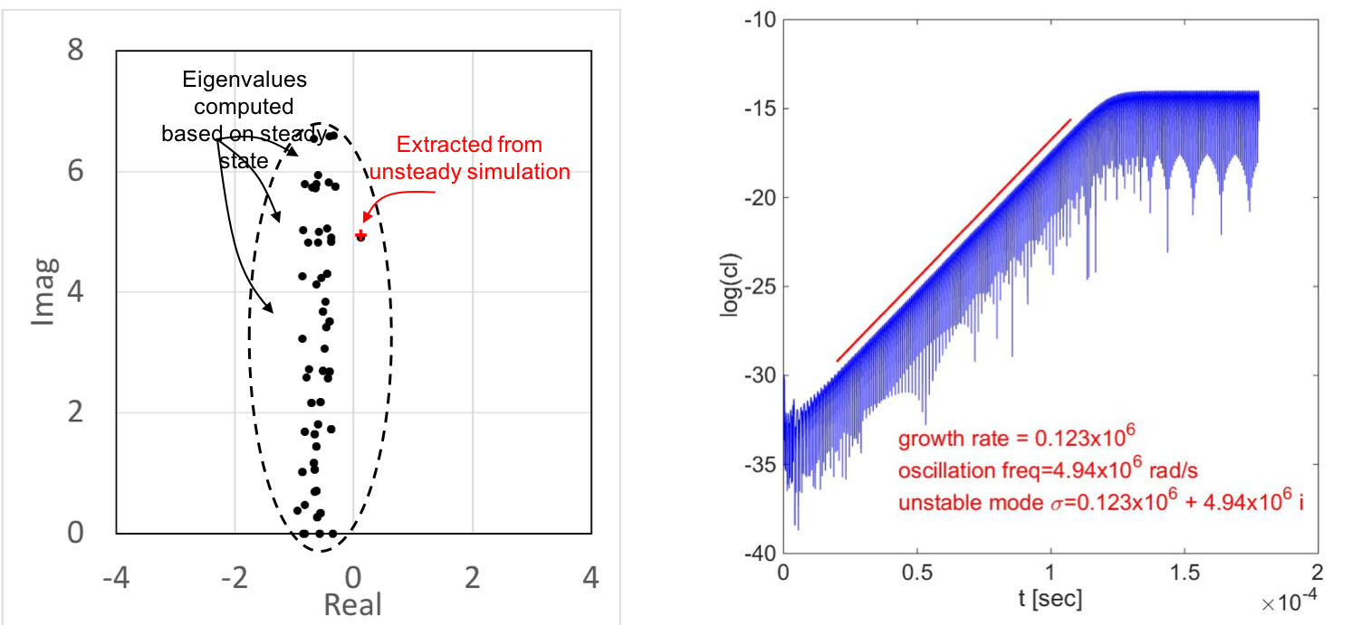
Eigenvalue analysis for Re=55

Slide 19
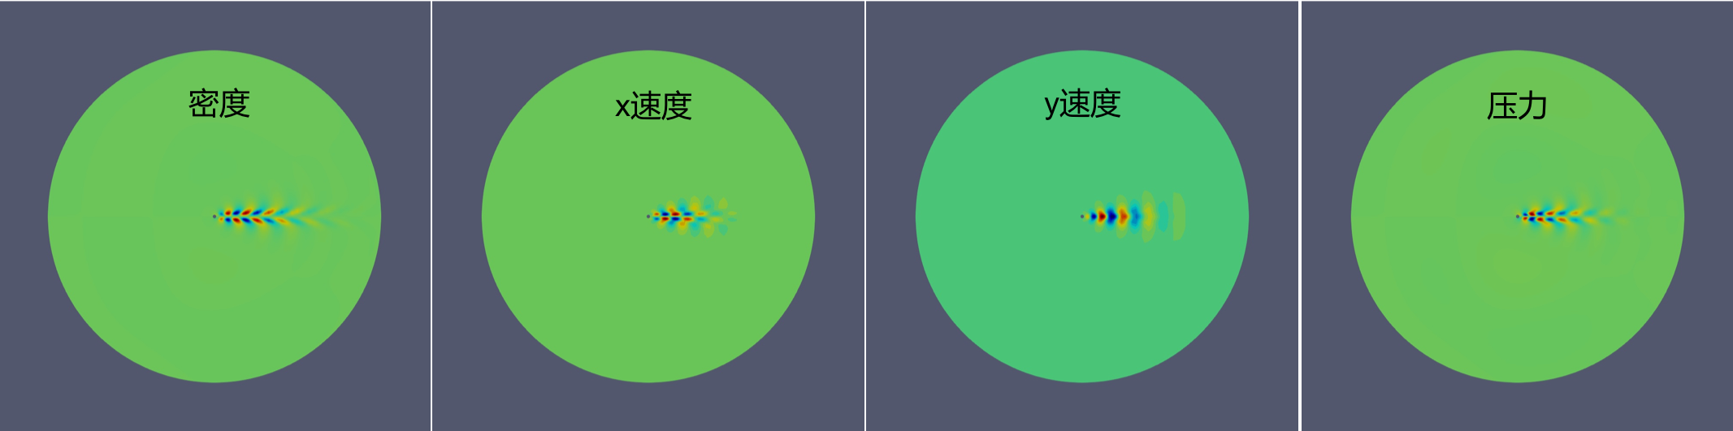
Unstable mode for Re=55 (real component)

Slide 20
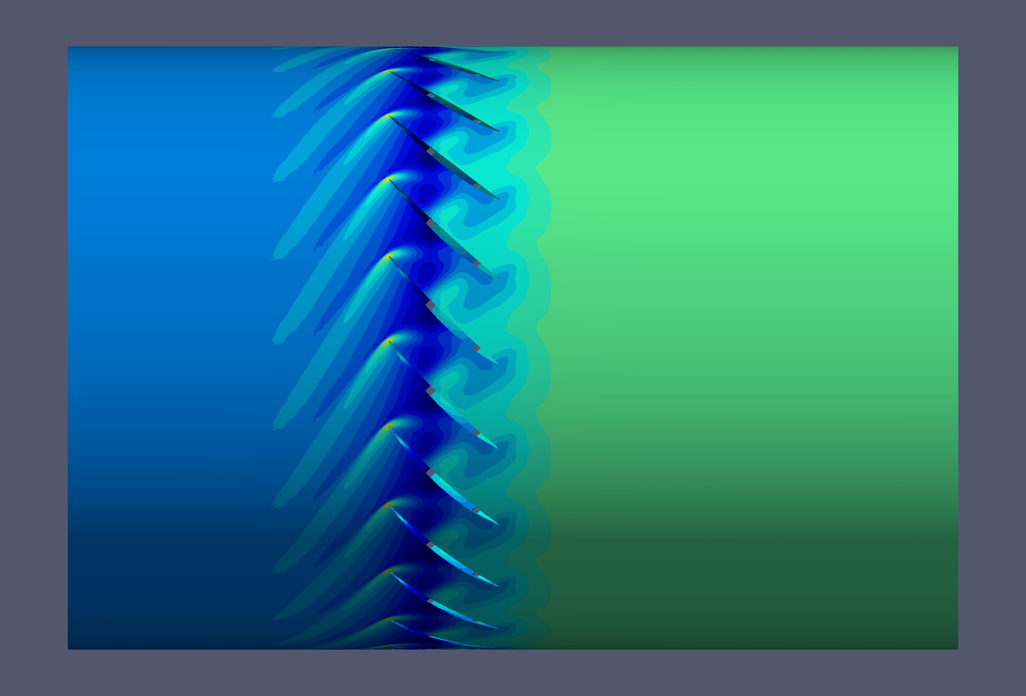
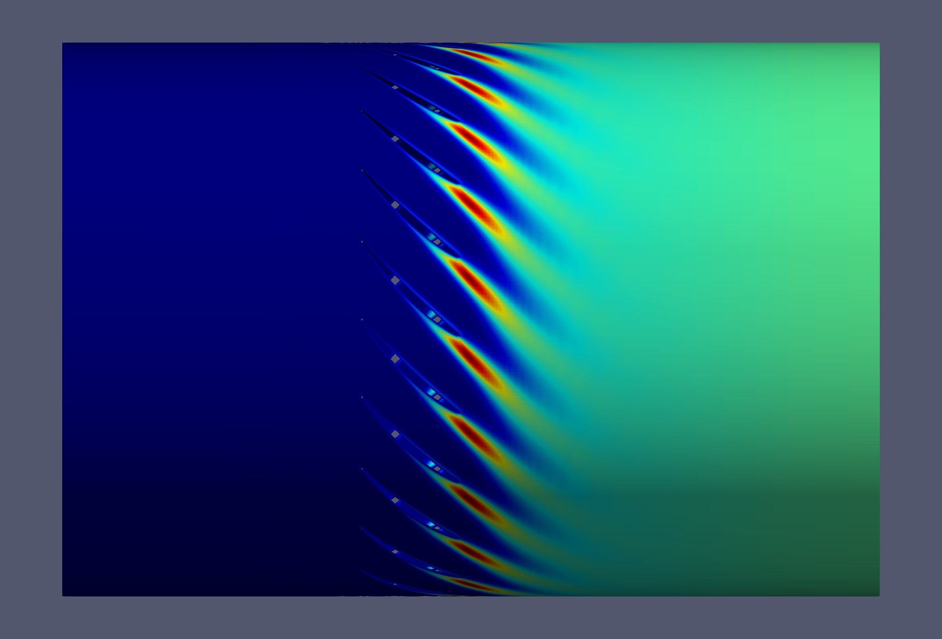
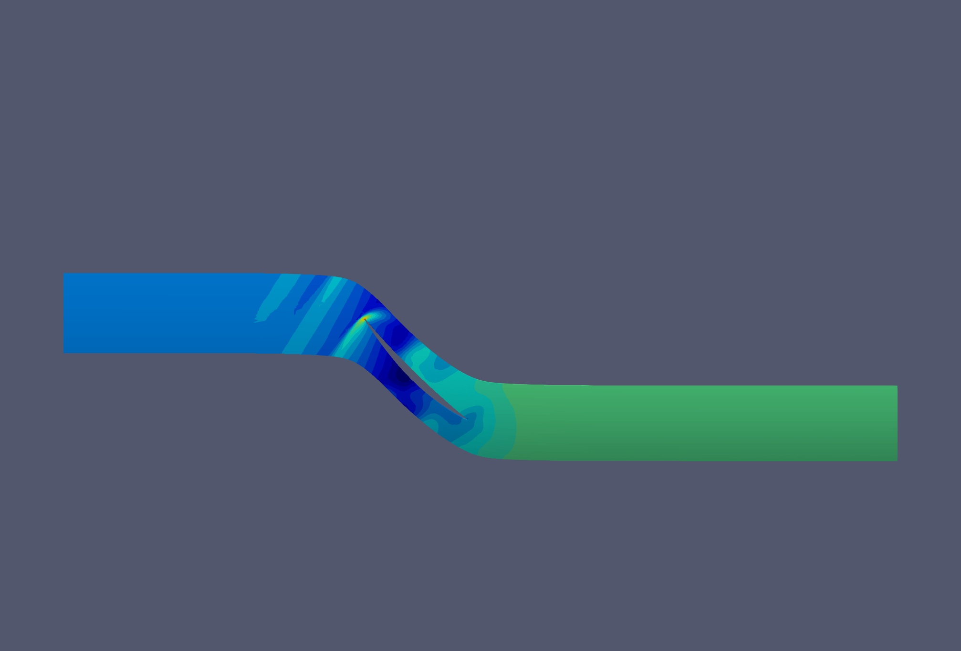
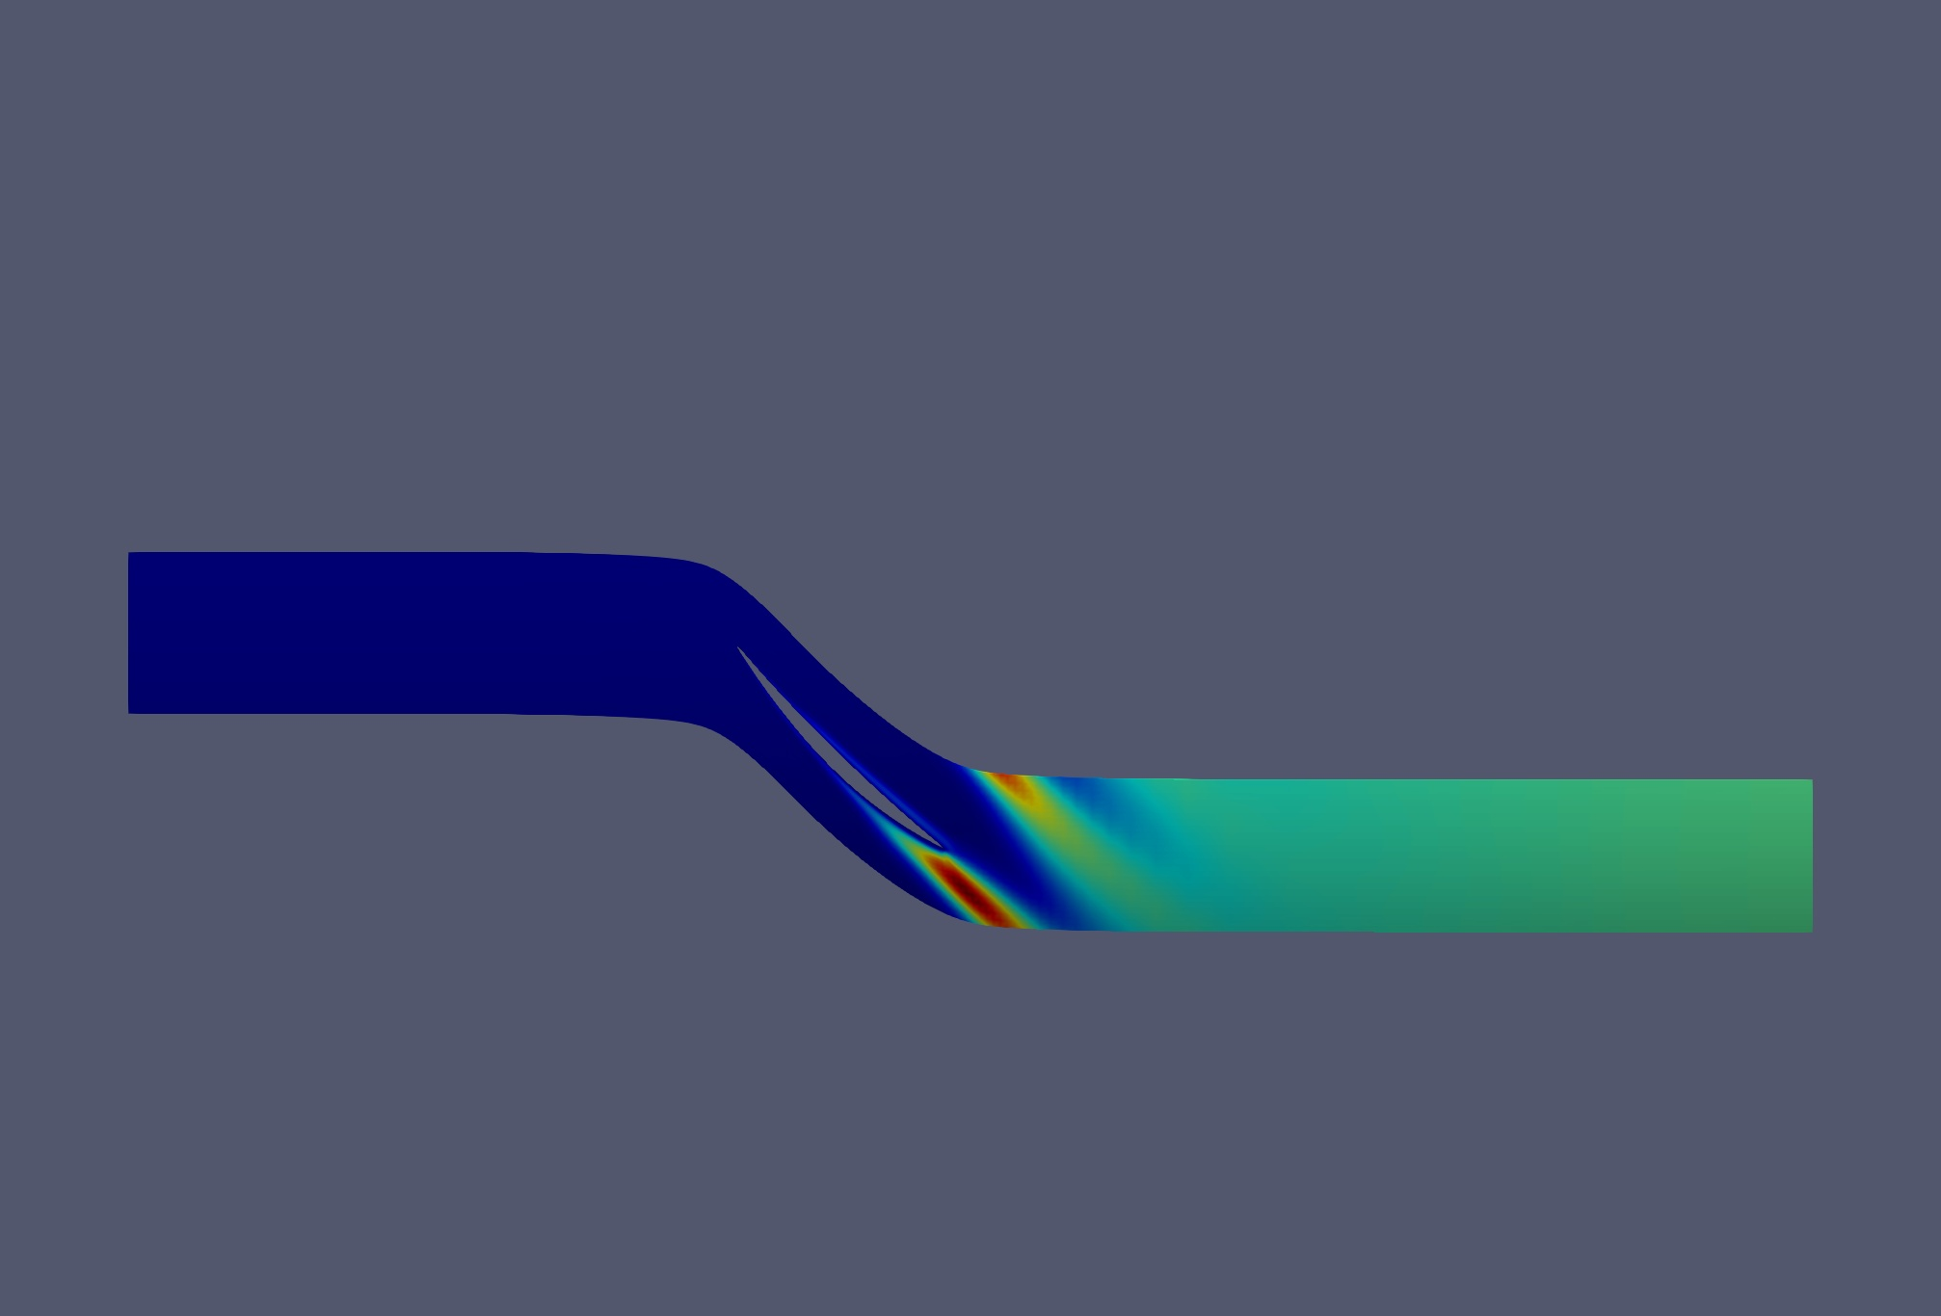
Case 2: annular cascade (R67 at 50% height)
Static pressure SA variable

Slide 21
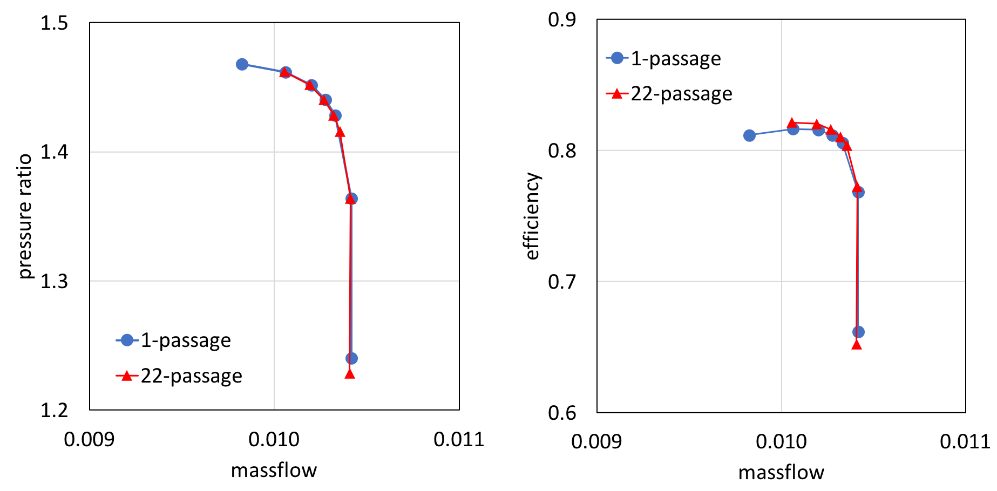
Steady state performance

Slide 22
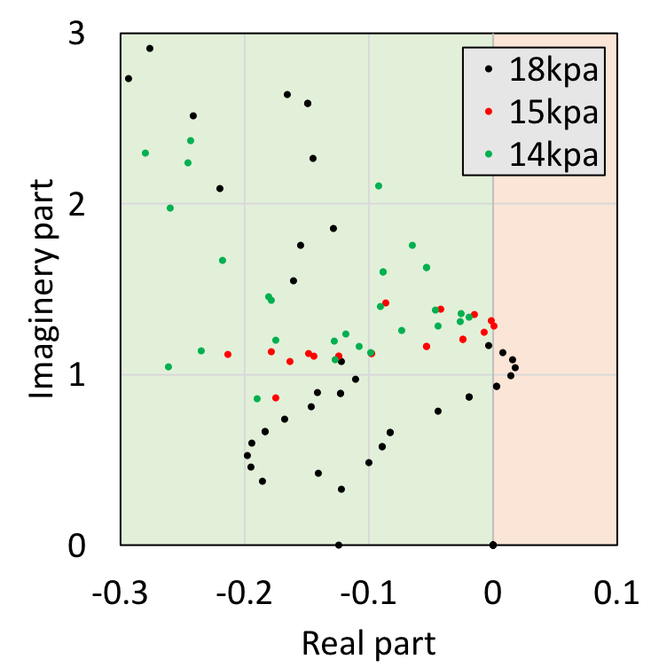
Eigenvalue analysis for near stall point
Real part of eigenvector 1 (18kpa)

Slide 24
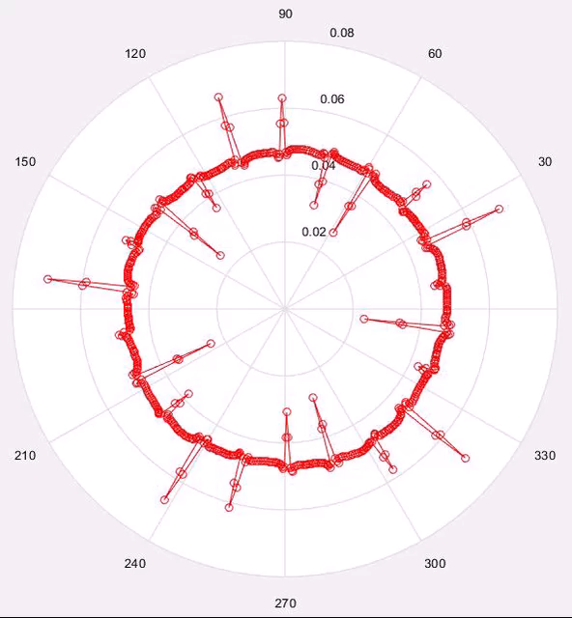
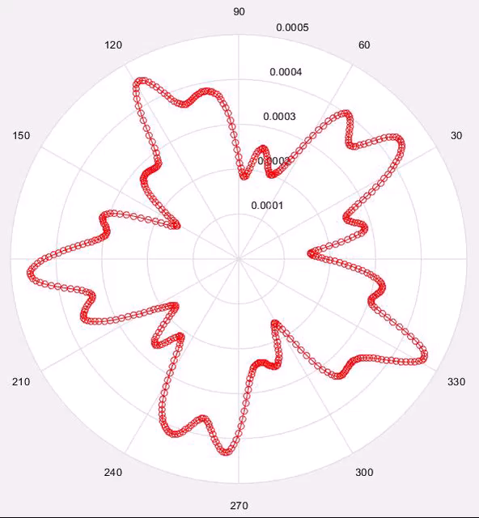
Reconstructured time-dependent signal

Slide 25
Physical interpretation of these modes?
Why are there modes with ND=5, 17? How do I separate them?
URANS simulation for confirming the eigenvalue prediction?

